Slide 1


TEST
IMPACT MANAGEMENT CAPABILITY
ASSESSMENT
REPORT
RELATIV IMPACT
MARCH 2024

Slide 2
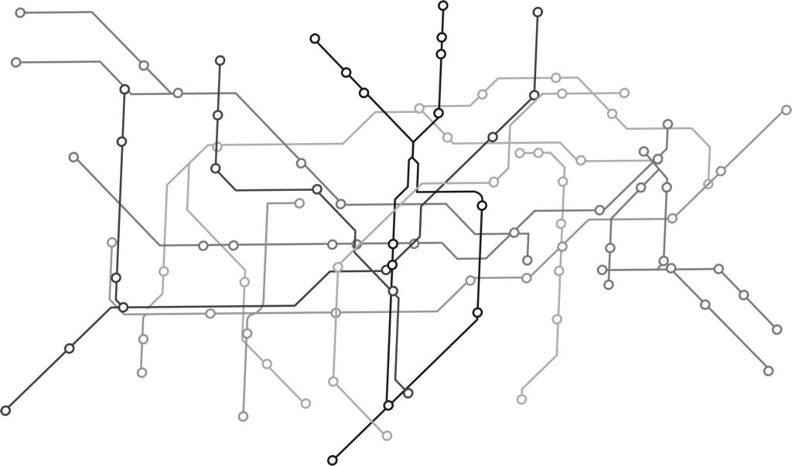
Contents
01
Introduction
02
Results
03
Next Steps
04
Appendices
Capability ASSESSMENT Report

Slide 3
INTRODUCTION
1

Slide 4
Introduction
Thank you for embarking on this journey of discovery and development with us.
We trust the process in itself will be valuable and help facilitate and stretch your thinking on Impact Management, its role within your organization, and how maturing this capability in and across your organization can support more effective achievement of your impact goals and objectives.
This report is is based on your completion of the Impact Management Capability Assessment Survey. It is intended to give you a ‘point-in-time’ view of where you are currently, and what key actions you can take to further progress on your journey towards maturity and optimizing the value you can derive from Impact Management as a capability.
The core of the report includes the results of your Capability Assessment Survey at a high-level with a summary roadmap of potential actions, followed by a more detailed view of your results per dimension and the elements which make up each dimension of impact management as a capability. Each results section includes recommendations for key actions you can take. The report also reflects additional information including key terms and definitions; information about the capability maturity model used; the capability maturity assessment matrix that underlies the results mapping and typical journey of maturity; as well as a resource bank with links to our favourite resources, tools and literature on topics covered in the report that could assist with your planning to implement the recommendations.
It is important to note that developing and maturing a new capability is a journey, one that takes time and is likely to be ever-changing in line with the dynamic context and environment in which you work. The typical nature of organizational maturing, means you are likely to experience cycles of maturing and triggers that will prompt refinements and adaptations over time, rather than a single linear progression from a static point. So, continue to review progress, prioritize actions, and celebrate milestones in cycles along the way.
You will be able to complete the Impact Management Capability Assessment Survey multiple times in the future to track and review your progress over time, as well as to set new plans of actions to further mature in the future.
Capability ASSESSMENT Report

Slide 5

Shifts
Current and future state is considered to identify required shifts in key areas of the organisation’s impact management capability. These shifts can be used to develop an action plan (development path) to close gaps in each dimension.
GAP
CURRENT STATE
SHIFTS
DESIRED STATE
Unpack what is your current state of this capability per dimension
Pin-point the shifts we need to make to realise your ideal state in each dimension
Ideal future state is considered to be ‘mature’ in each dimension
Complete the Impact Management Capability Assessment
Automated assessment of gaps and recommended actions to close gaps and enhance maturity
Implemented recommended actions to close gaps and enhance maturity
Capability maturity model

Slide 6
Results : Overview
2

Slide 7
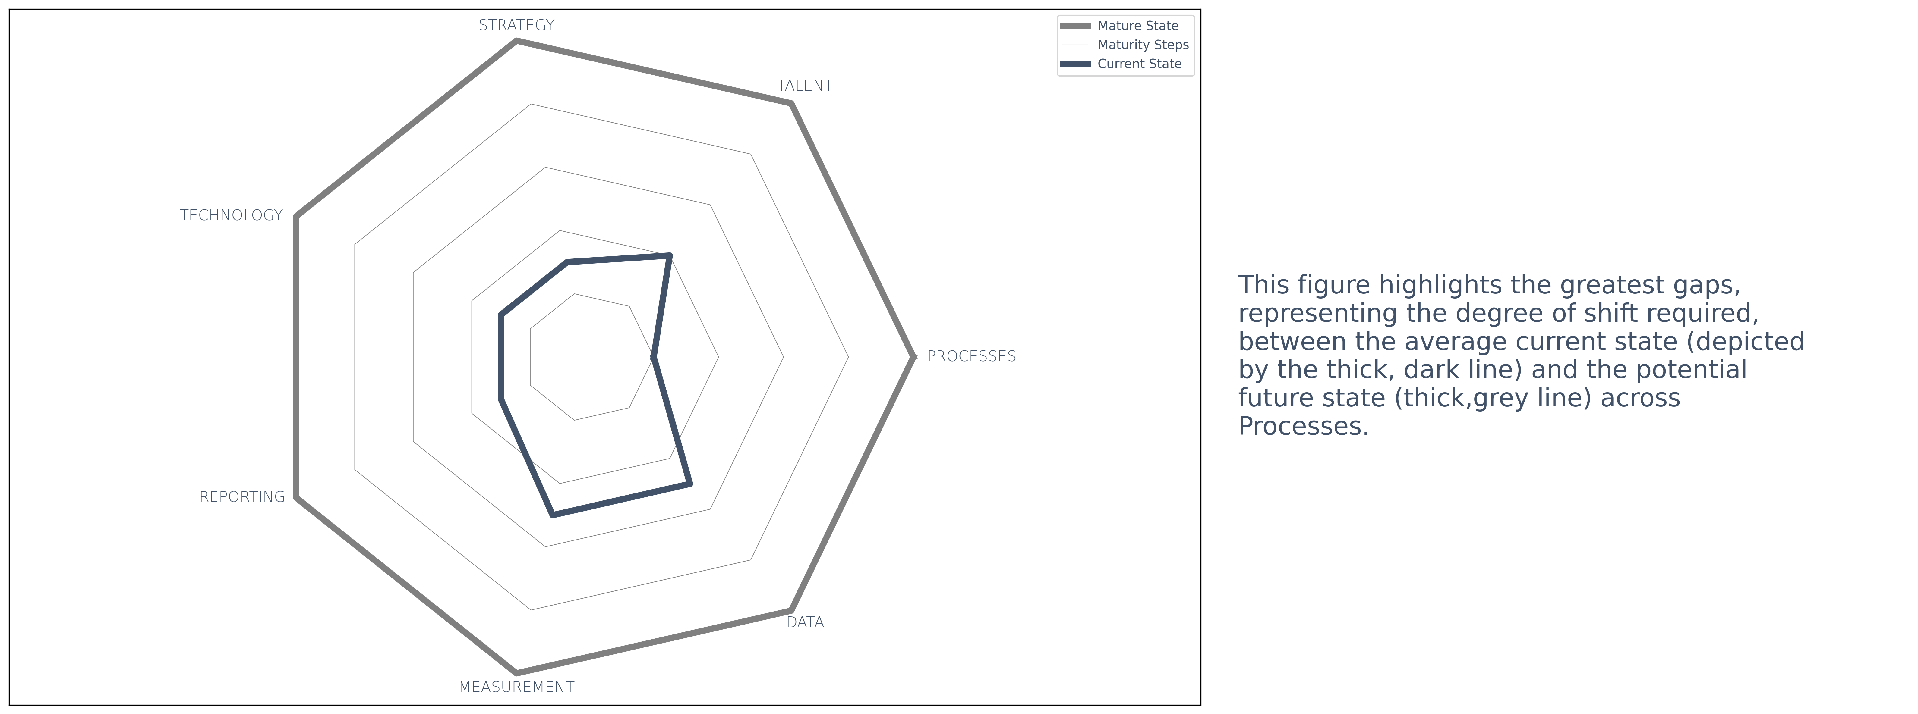
Overview
The figure below provides a summary view of the current state (where we are now) and future state (where we want to get to) across the capability dimensions. Where more than one element is included within a dimension, the average across all contributing elements is reflected, with equal weighting. This is followed by a detailed breakdown of the capability assessment results, considering key recommendations for actions per capability dimension, and each of the elements that make up the respective dimensions.
Capability ASSESSMENT Report

Slide 8
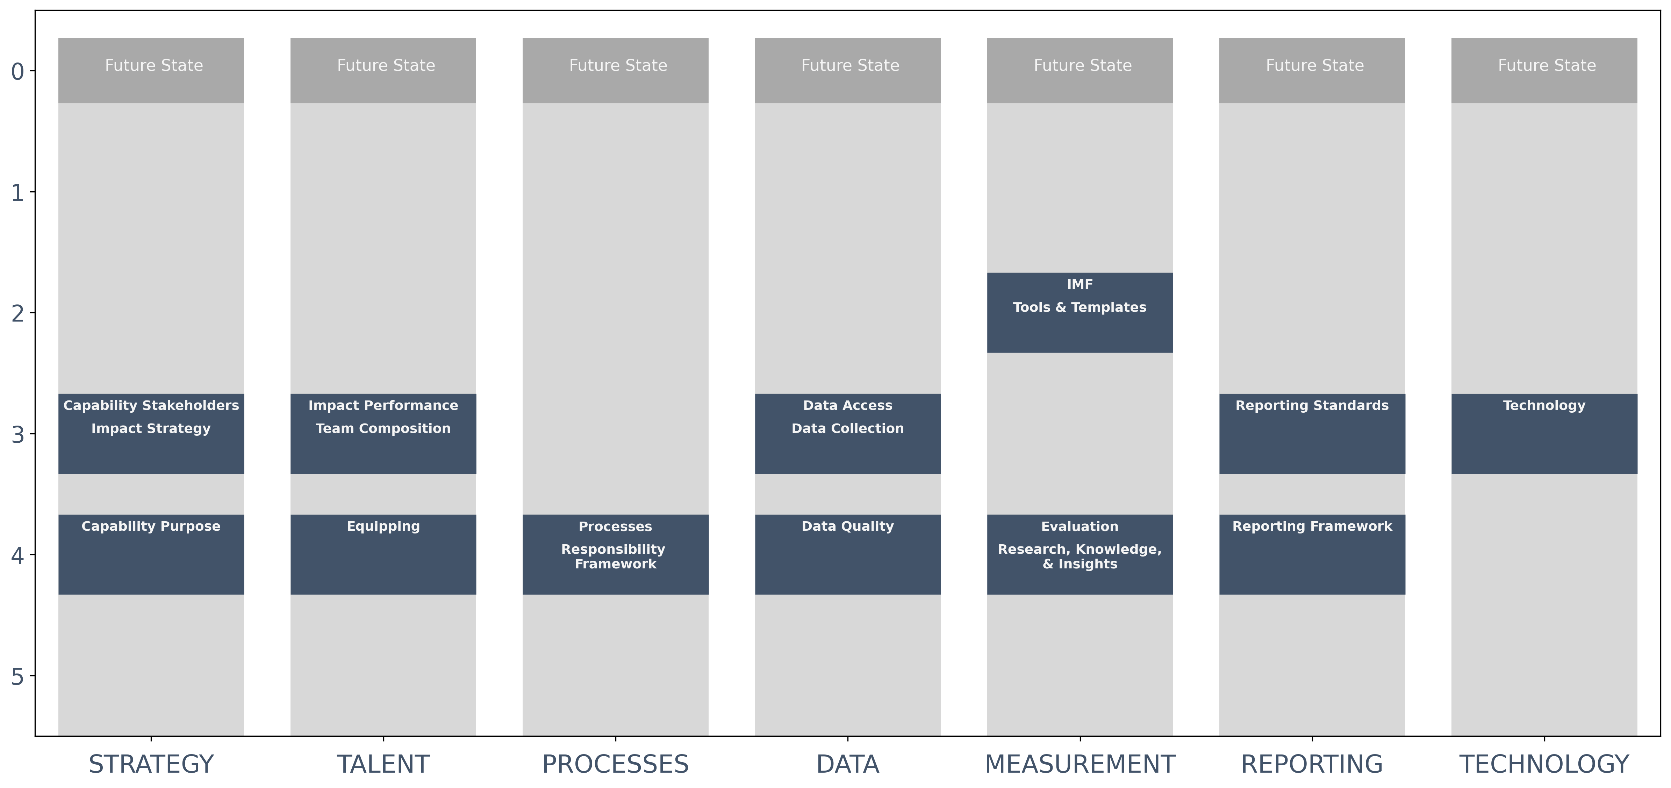
Steps to Future State
The figure below provides a more detailed view of the gaps (reflected as the number of ‘steps’) between current and future state in each element of the Impact Management Capability dimensions. The elements that are driving the greater degree of shift required between current and future states (in the next year) are:
Capability Purpose, Equipping, Processes, Responsibility Framework, Data Quality, Evaluation,
Research, Knowledge, & Insights, and Reporting Framework.
No. of Steps between current state and future state
Capability Dimension
Capability ASSESSMENT Report

Slide 9
SUMMARY Roadmap
Summary of key actions, highlighted through the recommendations:
1.
Refine, and finalise Impact Strategy (e.g. Theory of Change).
2.
Identify and develop relevant tools (e.g. data collection tools) to implement your mesurement framework.
3.
Identify and define data quality standards, frameworks, methods and supporting processes in line with Impact Measurement Framework.
4.
Develop and deploy standards collateral, templates and training to enable internal team and stakeholders to implement Impact
Management capability.
5.
Define capability model; Identify and develop high-level processes lead by IM capability; Develop responsibility assignment framework (PACE).
6.
Identify and define relevant reporting requirements and standards for the organisation.
7.
Identify, investigate and test relevant technology to enable the IM Capability in line with design and purpose.
Capability ASSESSMENT Report

Slide 10
RESULTS AND RECOMMNEDATIONS
3

Slide 11
Results : STRATEGY
1

Slide 12
KEY TERMS: Strategy
Impact strategy
An impact strategy clearly outlines your organisation's purpose. It is a detailed roadmap to achieve your intended impact and provides a long-term vision of how such impact will be achieved and measured to determine success (Investment Impact Index, 2019). This could take the form of a Theory of Change, impact thesis or something similar.
Capability Purpose
Each capability (defined as processes, tools, skills, behaviours, and organisation that help an organisation deliver an outcome) within an organisation has a purpose – a role to play in relation to achieving the organisation’s purpose and strategic objectives (PWC, 2019). Ideally, this purpose should be clearly aligned with the organisation's strategy and desired impact (Turner, Crawford & Hobbs, 2004).
Capability Stakeholders
Stakeholders are groups of people who gain direct benefits from or are affected by your organisation's operations (Benn, Abratt & O'Leary, 2016). Stakeholders could include shareholders, investors, beneficiaries, customers, employees, suppliers, financial supporters, and communities. In this case, we are considering the stakeholders served and / affected your impact management capability.

Slide 13
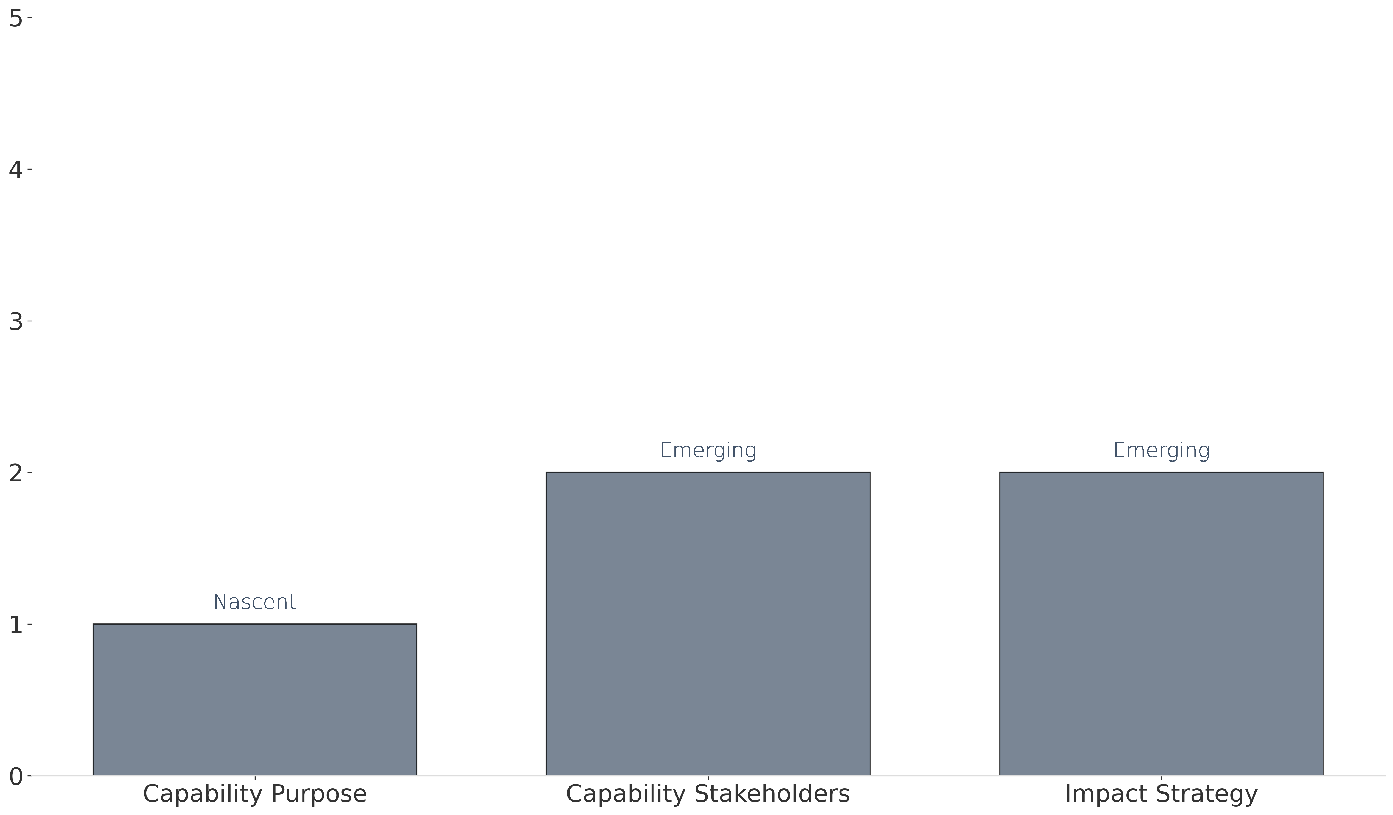
Results: Strategy
The graph below reflects your current stage of maturity in relation to strategy and the elements which constitute this dimension.
Legend: Levels of maturity
1. Nascent - little or no formal capability in this area
2. Emerging - Some establishment, but an early-stage / basic level
Maturity level
3. Expanding - Established, but still developing
4. Optimising - Established, applying improvements based on early-stage lessons
5. Mature - Fully-fledged and developed capability
Capability Dimension

Slide 14
Recommendations: Strategy
The table below outlines the recommended actions to close gaps towards intended future state across the Strategy dimension.
As the Impact Management capability is established, the purpose needs to be identified and prioritised in the context of
the organization and its strategy. Consideration needs to be given to the potential to spin off in the future and the
implications of this for the Impact Management capability and its position within the organization.​
CAPABILITY PURPOSE CAPABILITY STAKEHOLDERS
IMPACT STRATEGY
Define the stakeholders of the Impact Management capability to clarify and clearly articulate the purpose within the
context and operating structure.
It is recommended that a programme review and internal stakeholder engagement process supports and informs the
implementation of a Theory of Change for the organisation. The review process should seek to engage those with lived
experience (programme staff) implementing on the ground (those closest to the problem), to understand what is working
in the organisation’s current social service delivery, what is not working, what needs in the community are hindering
progress and what needs are a priority in order to build capacity and resilience within individuals and communities.
Capability ASSESSMENT Report

Slide 15
RESULTS : TALENT
2

Slide 16
KEY TERMS: TALENT
Team Composition
Team composition refers to the overall mix of characteristics among people in a team. This involves putting together individuals with the relevant skill sets and expertise, to not only help a team accomplish its goals, but to also maximise the team's overall effectiveness (Cooke & Hilton, 2015).
Impact Performance
This refers to how well a person, project, or programme is performing against planned impact goals or objectives (Global Impact Investing Network, 2023a). Various metrics and data points help to provide a view of this performance.
Equipping
This refers to processes, tools, and templates that are created and utilised to support the Impact Management process (Stories for Impact 2024).

Slide 17

Results: TALENT
The graph below reflects your current stage of maturity in relation to talent and the elements which constitute this dimension.
Legend: Levels of maturity
1. Nascent - little or no formal capability in this area
2. Emerging - Some establishment, but an early-stage / basic level
Maturity level
3. Expanding - Established, but still developing
4. Optimising - Established, applying improvements based on early-stage lessons
5. Mature - Fully-fledged and developed capability
Capability Dimension

Slide 18
Recommendations: TALENT 1/2
The table below outlines the recommended actions to close gaps towards intended future state across the Talent dimension.
Identify standardised templates, tools, processes, and training (collateral) to ensure consistent implementation of
processes lead by the Impact Management Capability. (This can be prioritised once initial capability design is in place
and the capability is established, with a workplan and prioritization of collateral to develop).​ If recruitment to fulfil
the team composition requirements is slow and / a lower job level is required on a permanent basis, there will be a
lag on the development of consistent collateral and training coming from the Impact Management Capability. This will
have a knock-on effect on implementation of impact measurement. ​A partner could assist initially to identify and /
develop specific standardised collateral (templates, tools, processes and training) to equip teams within the organization.
In line with stated objectives, talent within the Impact Management Capability would also need to develop capacity to
maintain and improve this over time and serve the growth and needs of the organization (consideration for developing
job profiles).
EQUIPPING
IMPACT PERFORMANCE
Work with HR to implement individual Impact Performance to accommodate for alignment of individual scorecards and
performance management to the Impact Strategy. This can be a broader exercise for the way individual performance is
considered within.​ Develop a plan to execute and integrate this approach - including required communications and
training of talent across all levels of the organization to co-create aligned individual scorecards and performance
management processes accordingly.
Capability ASSESSMENT Report

Slide 19
Recommendations: TALENT 2/2
The table below outlines the recommended actions to close gaps towards intended future state across the Talent dimension.
If an existing senior leadership team member does not have relevant skills, qualifications and expertise in Impact
Management, an additional role (this may include advisory capacity in the early stages) should be created and
planned for incorporation into the structure. ​In conjunction with Process development recommendations, develop
a capability design process to develop the capability by unpacking: the ‘job-to-be-done’ by the Impact Management
Capability; defining the capability model (the Impact Management sub-capabilities needed); define the boundaries
of the Impact Management Capability (what it does do and what it doesn’t do); identify the high-level processes this
capability will need to lead in order to fulfil the purpose and stakeholder needs; determine the responsibility
assignment framework PACE. This provides a clear view of the different roles that are required, and in conjunction
with consideration of volume of work, can inform the number of people that may be required to fulfil these roles.
TEAM COMPOSITION
Capability ASSESSMENT Report

Slide 20
RESULTS : PROCESSES
3

Slide 21
KEY TERMS: PROCESSES
Processes
Processes are sets or groups of related activities carried out by the organisation (Faugier-Contreras, Guevara-Flores & Hernández-Calderón, 2023). Here we are considering any processes which help an organisation understand, act on, and communicate its impact.
Responsibility framework
A responsibility framework outlines the roles and responsibilities of the processes lead by and / performed within the Impact Management Capability (Zein, 2010).

Slide 22
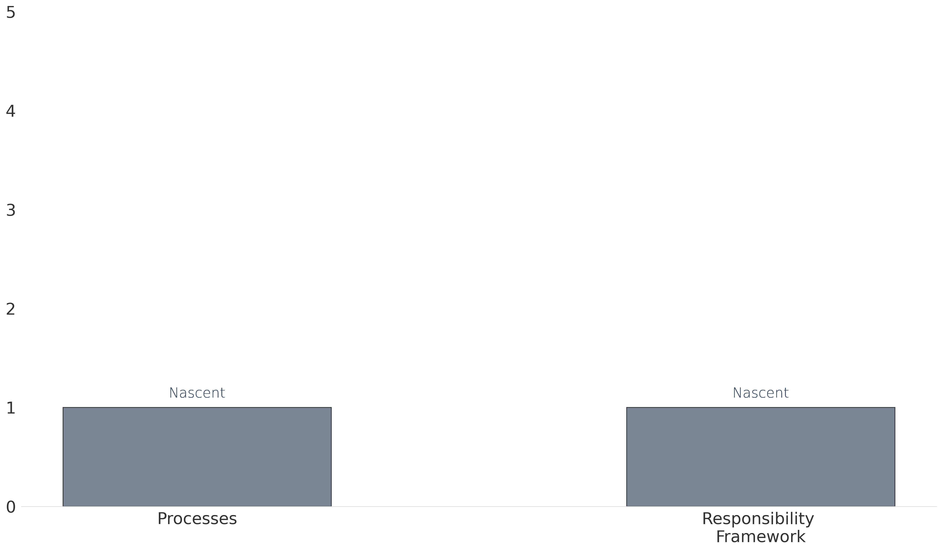
Results: PROCESSES
The graph below reflects your current stage of maturity in relation to processes and the elements which constitute this dimension.
Legend: Levels of maturity
1. Nascent - little or no formal capability in this area
2. Emerging - Some establishment, but an early-stage / basic level
Maturity level
3. Expanding - Established, but still developing
4. Optimising - Established, applying improvements based on early-stage lessons
5. Mature - Fully-fledged and developed capability
Capability Dimension

Slide 23
Recommendations: PROCESSES
The table below outlines the recommended actions to close gaps towards intended future state across the Processes dimension.
Identify a capability design process to develop the capability by unpacking: the ‘job-to-be-done’ by the Impact Management
Capability; defining the capability model (including the Impact Management sub-capabilities needed); define the boundaries
of the Impact Management Capability (what it does do and what it doesn’t do); identify and define the high-level processes
this capability will need to lead in order to fulfil the purpose and stakeholder needs; determine the responsibility assignment
framework PACE. See example of PACE application. The capability design process above will assist to inform the development
of role profiles (based on PACE); and workplans.​
PROCESSES & RESPONSIBILITY FRAMEWORK
Capability ASSESSMENT Report

Slide 24
RESULTS : DATA
4

Slide 25
KEY TERMS: DATA
Data access
This refers to how readily accessible and available data is to enable relevant internal and external stakeholders to utilise data to make decisions and meet their needs (National Academy of Sciences et al., 2009).
Data collection
Data collection is the process of gathering information which will enable one to answer relevant questions and evaluate outcomes (Harwood & Vang, 2009).
Data quality
Data quality considers how well the data management system reflects the real world. Dimensions of data quality include accuracy, reliability, completeness, precision, timeliness, integrity, and confidentiality (Brown, 2007).

Slide 26
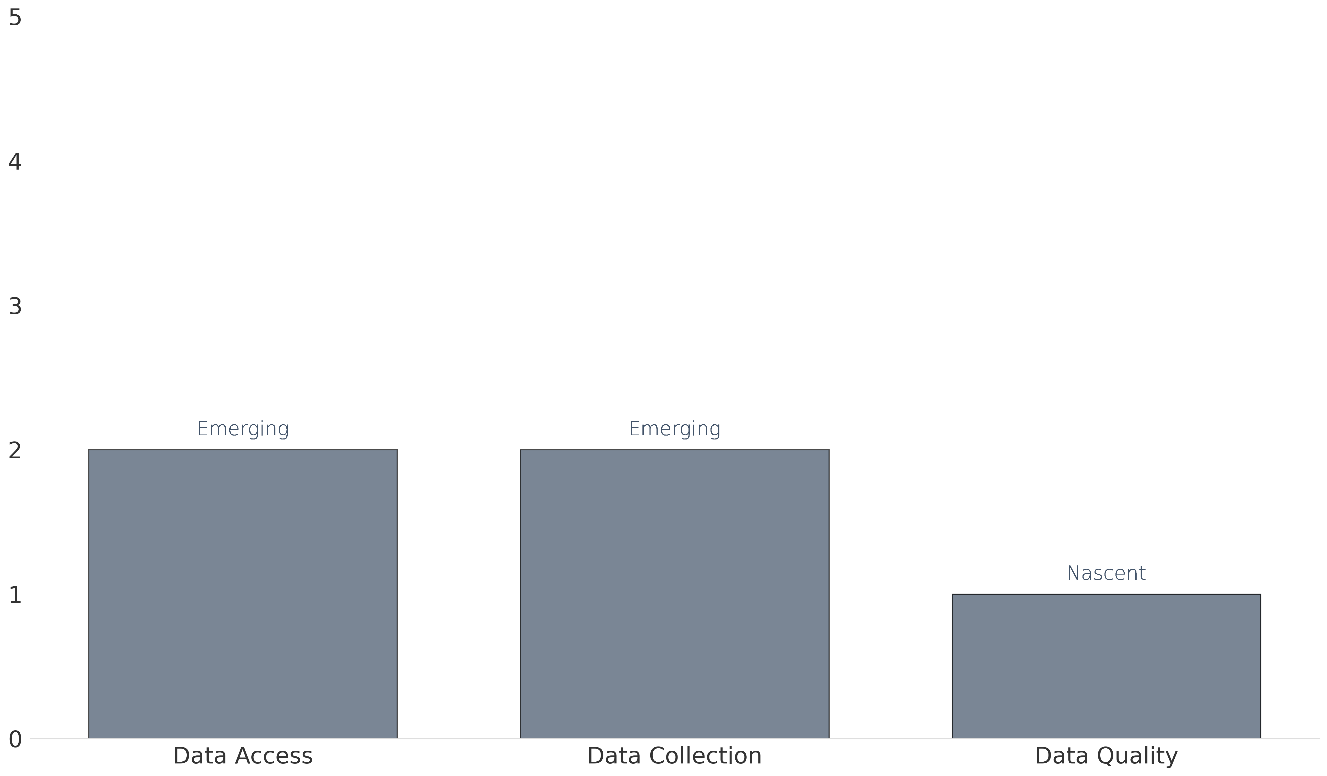
Results: DATA
The graph below reflects your current stage of maturity in relation to data and the elements which constitute this dimension.
Legend: Levels of maturity
1. Nascent - little or no formal capability in this area
2. Emerging - Some establishment, but an early-stage / basic level
Maturity level
3. Expanding - Established, but still developing
4. Optimising - Established, applying improvements based on early-stage lessons
5. Mature - Fully-fledged and developed capability
Capability Dimension

Slide 27
Recommendations: DATA
The table below outlines the recommended actions to close gaps towards intended future state across the Data dimension.
Develop enabling capabilities such as IT to determine where data needs to end up to ensure it can be accessed and used by
the right people at the right time, e.g. decision-makers and those who are contributing to, learning about and improving the
work of the organization and / programmes. Utilise the Impact Measurement and Reporting Frameworks (once developed)
to review and / identify the data access needs and timing that users have to inform the above. A review of user requirements
will inform data architecture and supporting processes for future. ​Ensure any data access rights / requirements are identified
and planned for (may include policies and access controls to protect data assets and meet regulatory requirements) with
appropriate systems, processes and people to remove bottlenecks to information access. ​
DATA ACCESS
Capability ASSESSMENT Report

Slide 28
Recommendations: DATA
The table below outlines the recommended actions to close gaps towards intended future state across the Data dimension.
Define and develop data collection tools, types of data collected and processes using the Impact Strategy and Impact
Measurement framework to select fit-for-purpose and fit-for context mix of tools, data types (and range to support
triangulation and participation), methods and processes. Progress discussions on Data Tools and Methodologies to support
primary data gathering.
DATA COLLECTION
DATA QUALITY
Identify the impact data architecture – the models, rules, and policies that will govern how impact data is captured, processed
and stored. ​Identify data quality and minimum standards to ensure results are an accurate reflection of what has occurred.
Capability ASSESSMENT Report

Slide 29
RESULTS : MEASUREMENT
5

Slide 30
KEY TERMS: MEASUREMENT
Impact Measurement Framework
An impact measurement framework builds on a Theory of Change by identifying the data which should be collected to understand, assess, and illustrate your impact (Spark Strategy, 2023). It includes measures that your organisation will use to evaluate the change that comes about as a result of your activities.
Tools and templates
These are the tools and templates that enable your team to implement your impact measurement framework. These may include templates, user guides, and process notes to guide implementation of impact measurement to plan (Global Impact Investing Network, 2023b).
Evaluation
There are many types of evaluation, and so defining a particular type of evaluation can be difficult. However, what is common across all types of evaluation is evaluative thinking. Evaluative thinking can be defined as critical thinking and reflection which is primarily motivated by curiosity and inquisitiveness, as well as valuing evidence (CDC, 2018). This includes identifying assumptions, asking questions, and continuous commitment to learning (Archibald, 2013). This assessment therefore utilises the term 'evaluation' broadly, and as referring to evaluative thinking.
Research, knowledge and insights
This may include research into underlying theory, best practices, market research, insights from evaluations, and knowledge from data (McKinsey & Company, 2022).

Slide 31
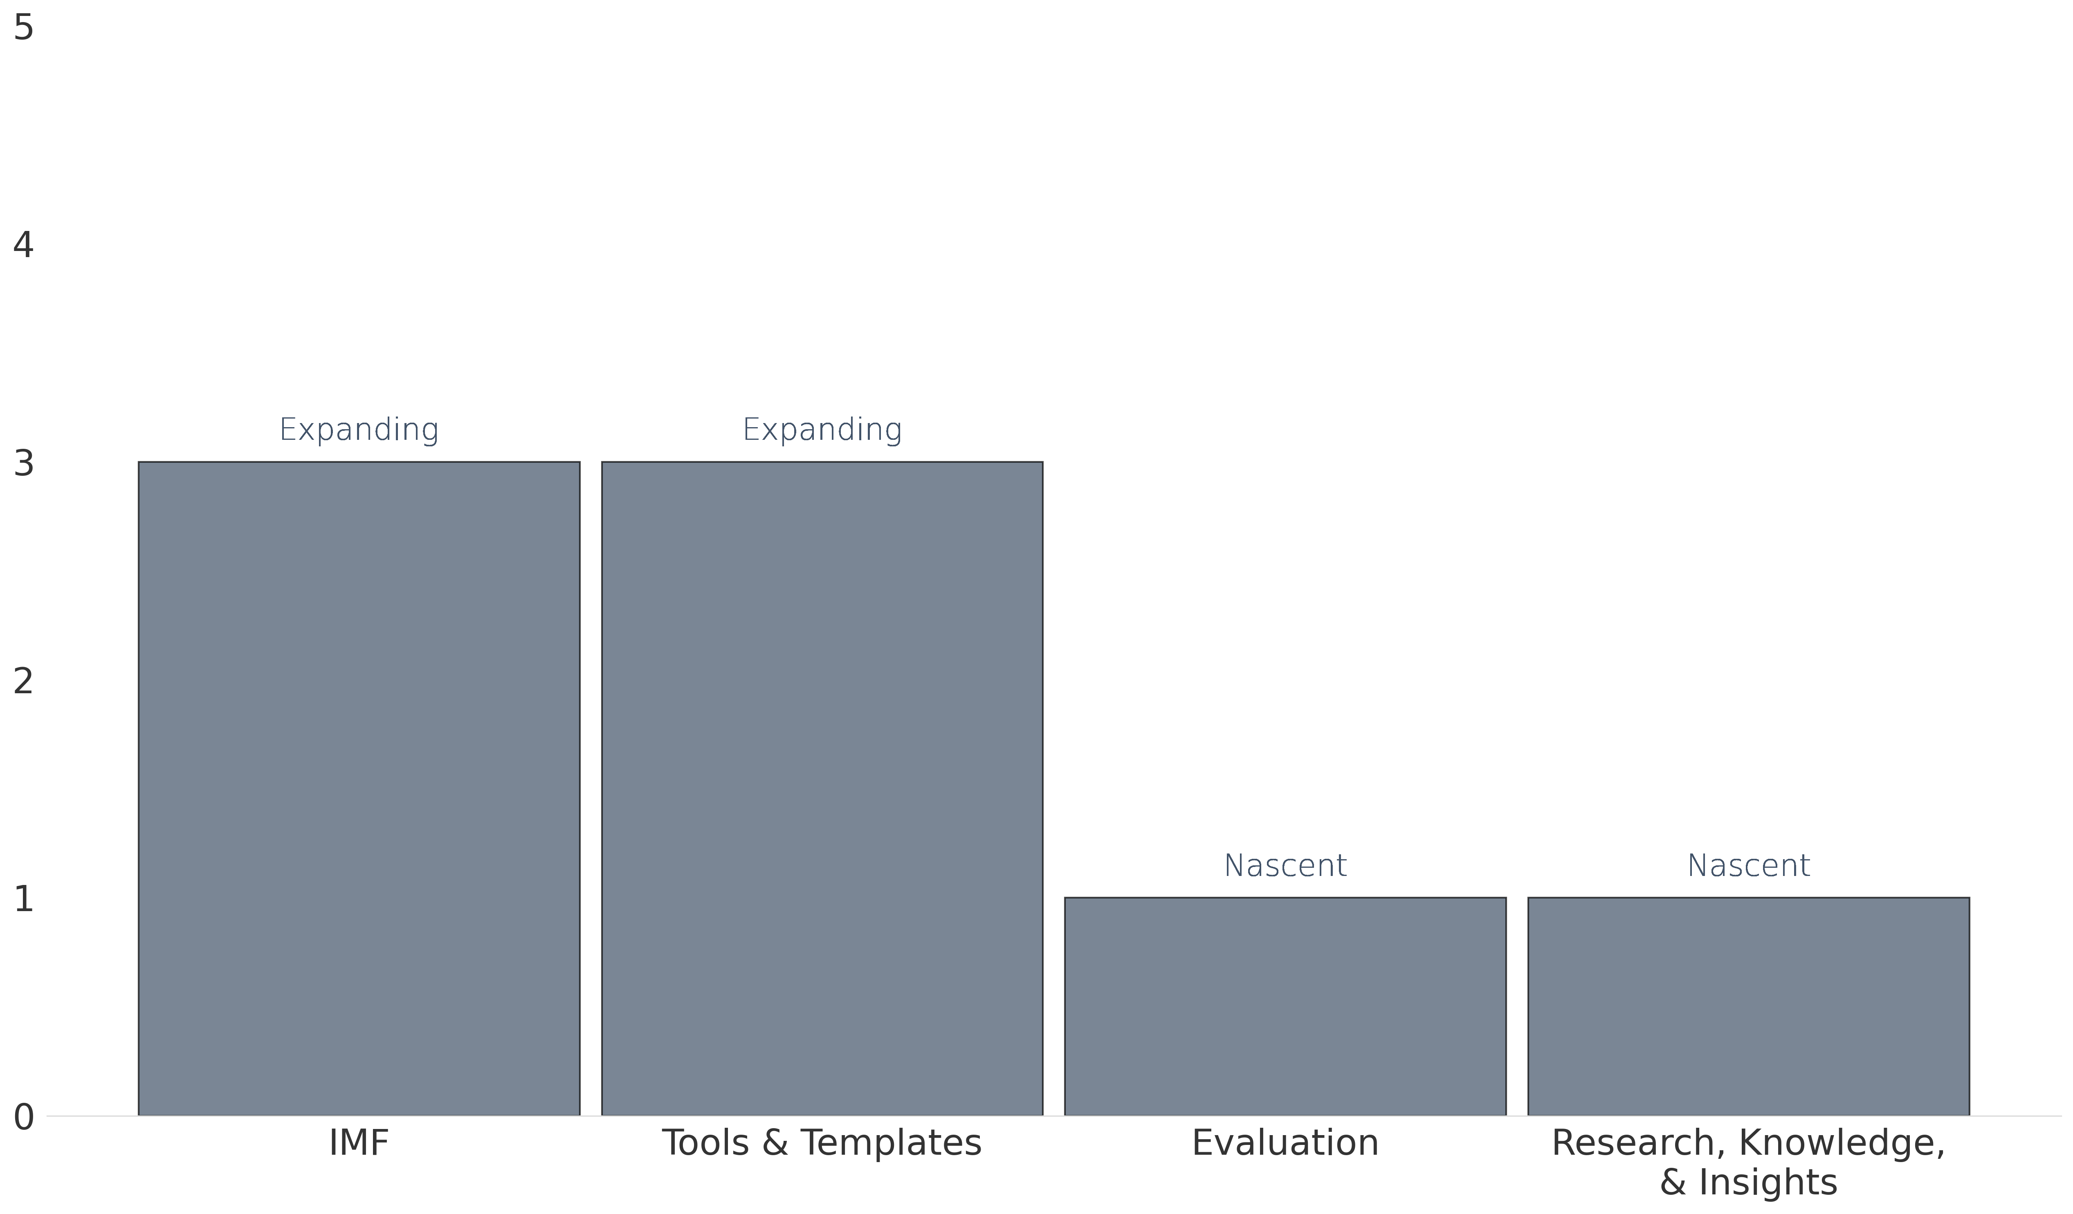
Results: MEASUREMENT
The graph below reflects your current stage of maturity in relation to measurement and the elements which constitute this dimension.
Legend: Levels of maturity
1. Nascent - little or no formal capability in this area
2. Emerging - Some establishment, but an early-stage / basic level
Maturity level
3. Expanding - Established, but still developing
4. Optimising - Established, applying improvements based on early-stage lessons
5. Mature - Fully-fledged and developed capability
Capability Dimension

Slide 32
Recommendations: MEASUREMENT 1/2
The table below outlines the recommended actions to close gaps towards intended future state across the Measurement dimension.
Finalize and implement well-defined indicators that are consistent (build time series data to track and understand performance
over time), and clearly stated with specific parameters within the Impact Measurement Framework (IMF) – for each level of the
Theory of Change. See the example Impact Measurement framework overview to guide the type of information typically
included in the Impact Measurement Framework. Ensure all new ‘programmes’ (and / communities operating in) have aligned
Impact Measurement Frameworks as they are built out and are incorporated end-to-end. Include stakeholder engagement in
the process to ensure measures identified are practical and you are able to collect the proposed data in practice. Combine this
stakeholder engagement with the selection of appropriate tools that are fit-for-context (i.e. relevant for the organization's
operating environment, stakeholders and capabilities) and fit-for-purpose.
Impact Measurement Framework
Tools and Templates
Finalize and implement the templates and training (see ”equipping” in Talent dimensions) required to socialise the Impact
Measurement framework and associated tools and processes across all levels of the organization and enable execution to
plan. Finalize and implement a plan for development of these consistent templates and training collateral (the comprehensive
set) and roll-out to support effective and consistent implementation.
Capability ASSESSMENT Report

Slide 33
Recommendations: MEASUREMENT 2/2
The table below outlines the recommended actions to close gaps towards intended future state across the Measurement dimension.
Finalize and implement the templates and training (see ”equipping” in Talent dimensions) required to socialise the Impact
Measurement framework and associated tools and processes across all levels of the organization and enable execution to
plan. Finalize and implement a plan for development of these consistent templates and training collateral (the comprehensive
set) and roll-out to support effective and consistent implementation.
EVALUATION
RESEARCH, KNOWLEDGE, AND INSIGHTS
Identify the need for incorporating regular evaluation and evaluative thinking practice within the initiative. Identify Key evaluation
questions that can be embedded into reflective processes and applied to monitoring data resulting from execution of the Impact
Measurement Framework.
Capability ASSESSMENT Report

Slide 34
RESULTS : REPORTING
6

Slide 35
KEY TERMS: REPORTING
Reporting framework
A reporting framework is a standardised system used to consistently report performance (Idowu et al., 2013).
Reporting standards
These standards provide principles for preparing reports and determine the types and amounts of information that must be provided to users so that they can make informed decisions (Global Reporting, 2024).

Slide 36
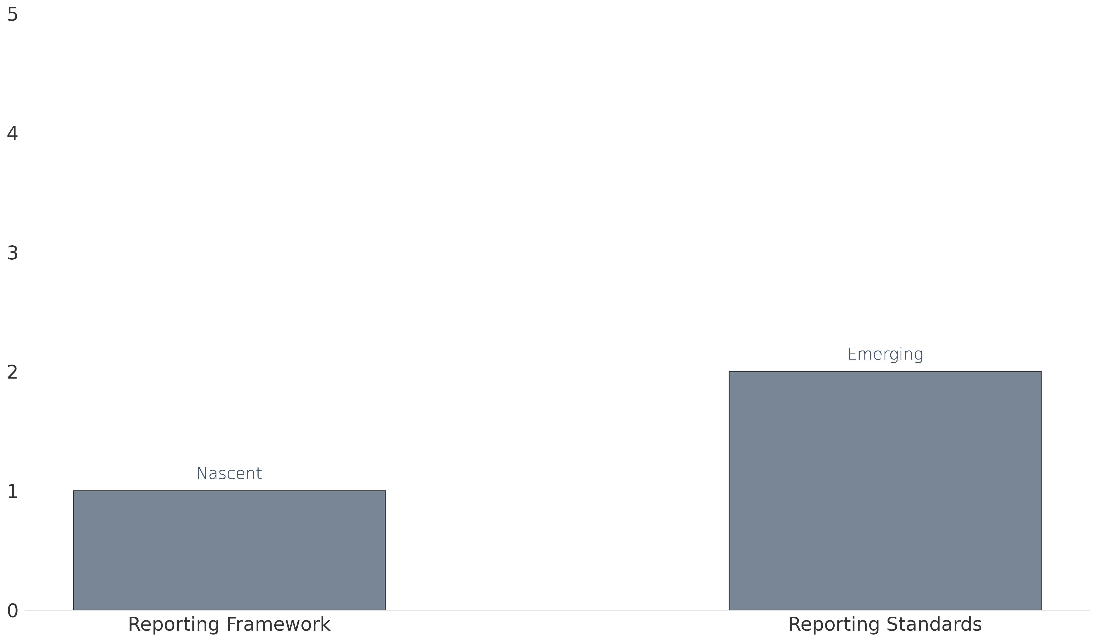
Results: REPORTING
The graph below reflects your current stage of maturity in relation to reporting and the elements which constitute this dimension.
Legend: Levels of maturity
1. Nascent - little or no formal capability in this area
2. Emerging - Some establishment, but an early-stage / basic level
Maturity level
3. Expanding - Established, but still developing
4. Optimising - Established, applying improvements based on early-stage lessons
5. Mature - Fully-fledged and developed capability
Capability Dimension

Slide 37
Recommendations: Reporting
The table below outlines the recommended actions to close gaps towards intended future state across the Reporting dimension.
Identify stakeholder reporting needs in relation to the Impact Strategy and IMF developed and associated timeframes (unlikely
given the range of stakeholders that automated reporting would be feasible and priority in year 1). ​Understand reporting
standards environment and implications. ​
REPORTING FRAMEWORK
REPORTING STANDARDS
​Select the standards that are relevant and develop plans for integration into processes, measurement, data and talent
competencies.​ Socialise reporting standards across the organization and relevant stakeholders to increase quality of
communication and materiality of disclosures.
Capability ASSESSMENT Report

Slide 38
RESULTS : TECHNOLOGY
7

Slide 39
KEY TERMS: TECHNOLOGY
Technology
Here, technology refers to using standardised tools and/or applications to support the processes and systems outlined throughout this report (Carvalho et al., 2021). These are technological means for collecting, measuring and/or illustrating impact.

Slide 40
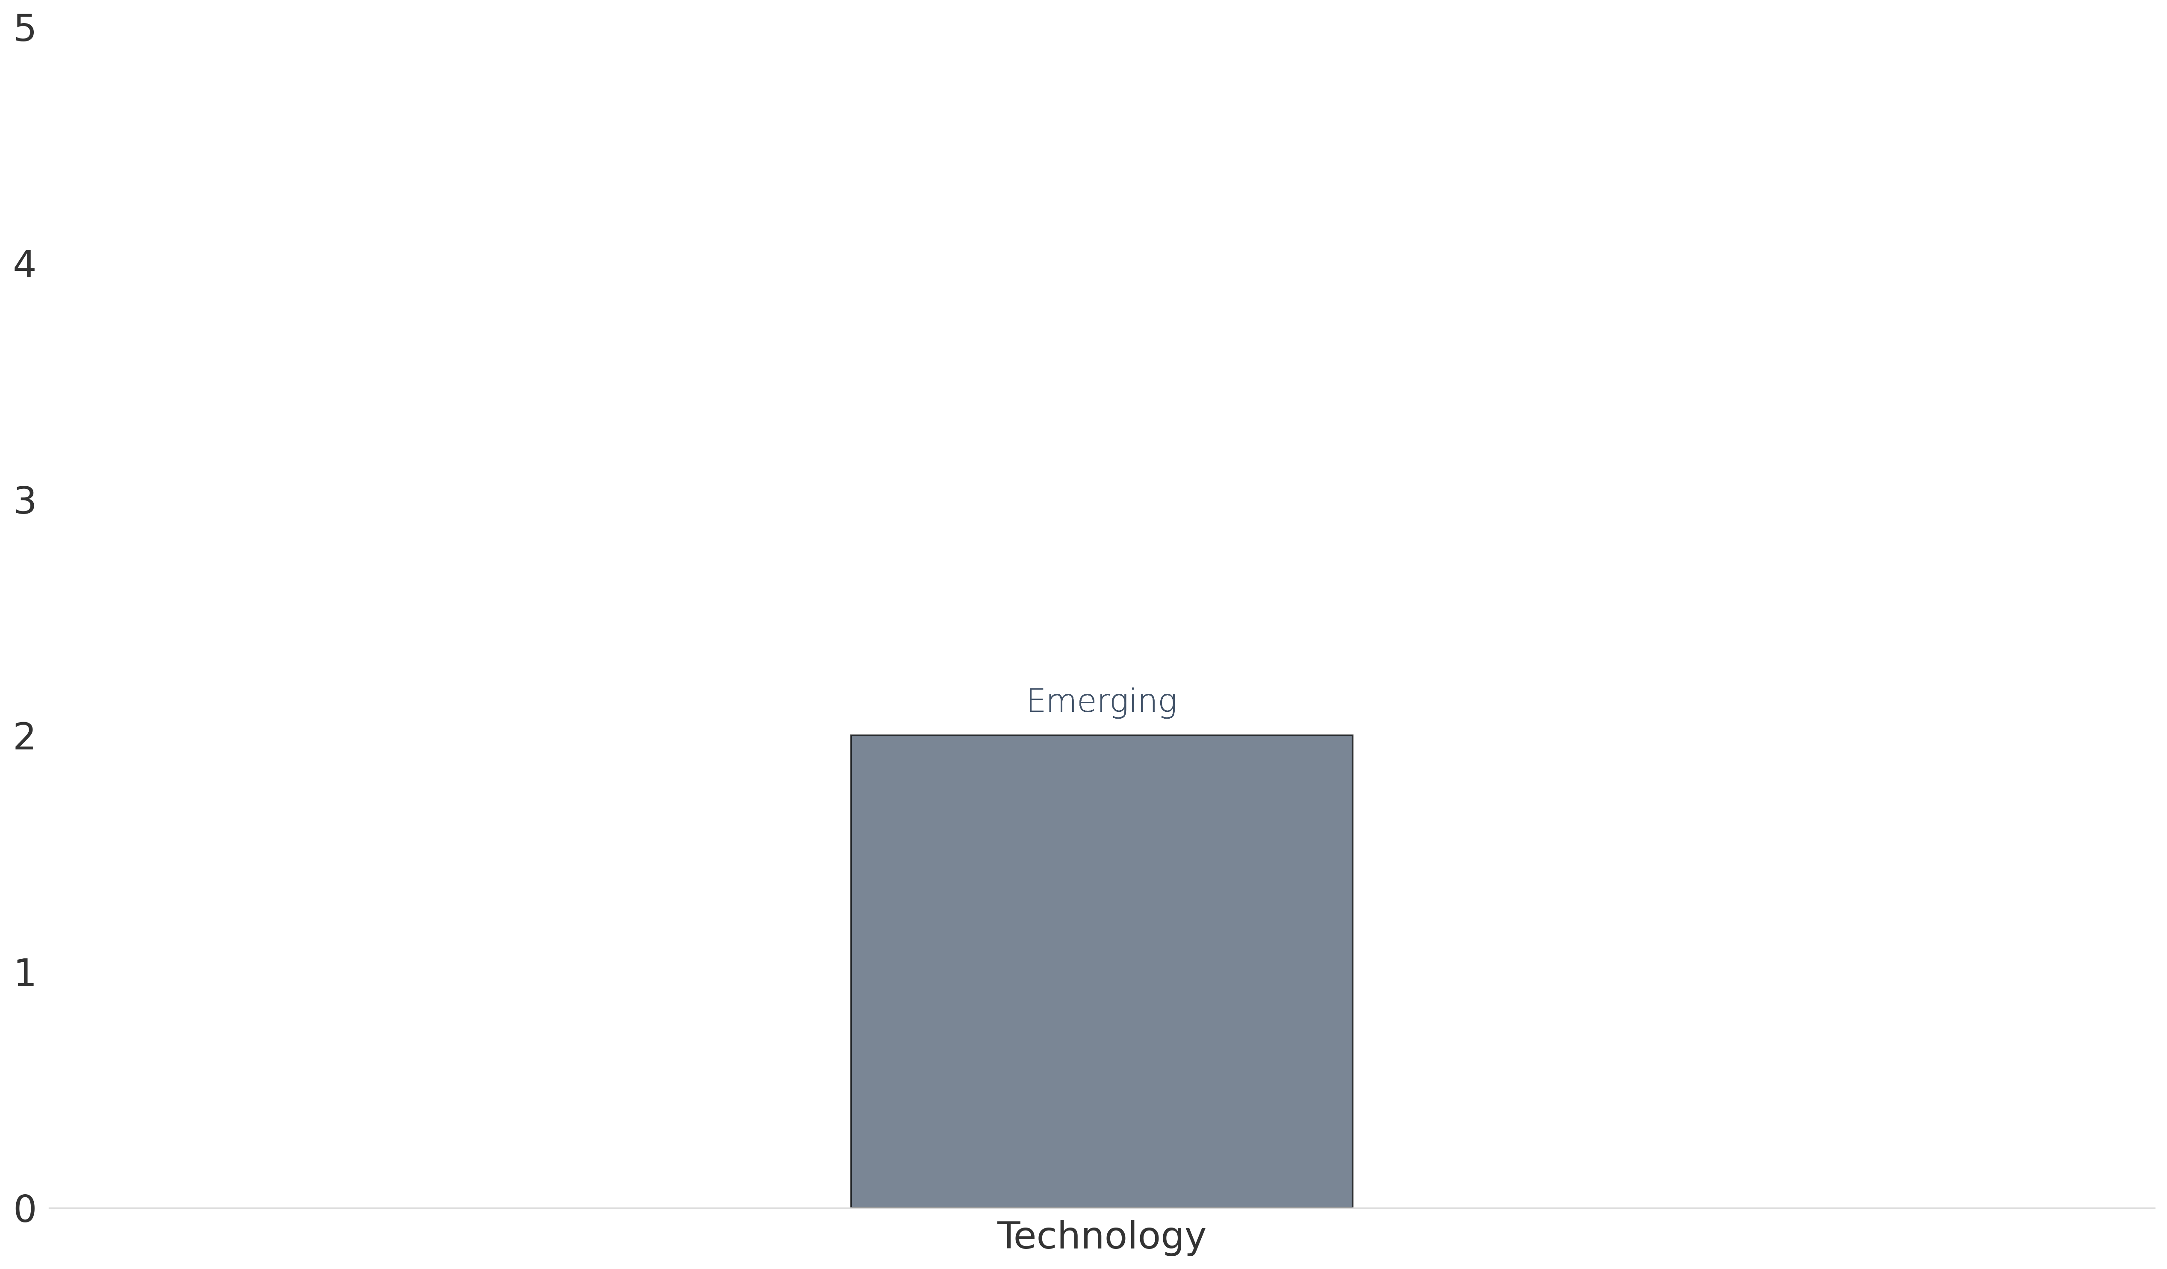
Results: TECHNOLOGY
The graph below reflects your current stage of maturity in relation to technology and the elements which constitute this dimension.
Legend: Levels of maturity
1. Nascent - little or no formal capability in this area
2. Emerging - Some establishment, but an early-stage / basic level
Maturity level
3. Expanding - Established, but still developing
4. Optimising - Established, applying improvements based on early-stage lessons
5. Mature - Fully-fledged and developed capability
Capability Dimension

Slide 41
Recommendations: TECHNOLOGY
The table below outlines the recommended actions to close gaps towards intended future state across the Technology dimension.
Implement the identified relevant tools and / applications and identify the best practices for use. Evaluation of tools and /
applications is set up.
Technology
Capability ASSESSMENT Report

Slide 42
NEXT STEPS
8

Slide 43
Next steps
It will be important for you to consider the extent to which these shifts will serve the broader organization to be able to make decisions as to the structure of the organization, with the inclusion of the Impact Management Capability.
We recommend reviewing the recommendations based on the future state pathway and plan timeframes for implementing prioritised elements, including priorities and actions for the next year. Identify implications for operational planning and budget processes.
Execute your plan and make positive shifts towards the key elements of the Impact Management Capability and its potential to realise strategic benefit for your organization and its stakeholders.
Hold yourselves accountable to your plans and track progress against implementation.
Review overall progress at the end of each year, and establish progress objectives for the following year, using the maturity assessment matrix.
Relativ is able to assist with capacity building in many of the areas of recommendation and would welcome the opportunity to discuss any specific elements.
Capability ASSESSMENT Report

Slide 44
APPENDICES
4

Slide 45
Appendix 1: MATURITY MODEL
1

Slide 46
CAPABILITY MATURITY TERMINOLOGY
Capability
A capability is an ‘ability’ or competency the organization requires to successfully fulfil its strategy and desired impact. Each capability fulfils a purpose / mission, performs processes that drive the work to be done. Talent with the skills to perform the work, as well as technology to enable the work.
Organization Capability Model
At an organizational level, the capability model represents the comprehensive set of capabilities the organization requires to fulfil its purpose / mission.
Capability maturity
When a capability’s purpose is aligned to business strategy, its desired impact can be achieved efficiently and effectively by the right people, doing the correct work and using the right technology and data. These efforts and effects, when correctly measured, can be linked back to assess and improve the desired impact.

Slide 47





Impact Capability Maturity Model
The capability maturity model defines the different levels of maturity associated with the growth and stabilisation of the capability. The closer capabilities are to fulfilling their intended purpose, the more mature they are.
Mature
This is now a fully-fledged, developed and integrated capability within the organization.
5
Optimizing
4
This capability area is established, and in the process of being improved through application of early-stage lessons.
Expanding
3
This capability area is established, but still developing.
Emerging
2
There is some establishment of this capability, but it is still at an early-stages / basic level.
Nascent
There is currently little or no formal capability in this area.
1
Source: Adapted from the Capability Maturity Model for Software and the Five levels of Software Process Maturity
Capability maturity model for Impact Management

Slide 48
Impact management capability dimensions
Maturity Level
Nascent
Emerging
Expanding
Optimizing
Mature
There is currently little or no formal capability in this dimension.
There is some establishment of this capability, but it is still at an early-stages / basic level.
This capability is established, but still developing.
Established, and in the process of improving through application of early-stage lessons.
This is now a fully-fledged, developed and integrated capability within the organization.
STRATEGY: Defines the organization’s purpose goals, objectives, target outcomes, pathways and milestones of change, and priority areas. Defines the purpose of the capability and its alignment to the purpose and strategy of the organization.
TALENT: Encompasses the staff and partners (service providers) that implement the activities of the organization broadly, and specifically within the Impact Management Capability and sub-capabilities, the organization and structure of talent to measure and management impact for the organization.
Processes: The processes (sets of related activities) required for the Impact Management capability and sub-capabilities to operate optimally and support the organization to achieve its intended purpose.
Technology: Technology infrastructure and software requirements that enable capabilities within the organization.
Capability Dimension
DATA: Data architecture, governance, policies rules and standards that govern the collection, storage, arrangement, integration and use of data across the organization.
MEASUREMENT: Develops and maintains the impact measurement frameworks (including definition of metrics, data collection methods, frequency, processes, tools, templates, baselines, targets and benchmarks) that track progress against strategy (at an organizational and programmatic level).
Reporting: Analysis of impact data, generation of actionable insights and reports that guide decision-making, evidence, improvement and accountability to key stakeholders (internal and external)
Capability maturity model For Impact Management

Slide 49
APPENDIX 2: CAPABILITY ASSESSMENT MATRIX
2

Slide 50
Dimension | Element | 1. Nascent - little or no formal capability in this area | 2. Emerging - Some establishment, but an early-stage / basic level | 3. Expanding - Established, but still developing | 4. Optimising - Established, applying improvements based on early-stage lessons | 5. Mature - Fully-fledged and developed capability
Strategy | Impact Strategy | We do not have a defined impact strategy in place - lack of clarity, consensus or documentation on specific goals, objectives, target outcomes and priority areas. | We have consensus on our impact strategy; however, we are in the early stages of formalising and documenting this in the form of a Theory of Change (or similar). It is not yet articulated in an explicit form and is not widely known, adopted or utilised within the organisation. | We have a documented Impact Strategy. It distinguishes between different levels of results and milestones along the change pathway towards our impact goals ( e.g., outputs, outcomes, impact goals) We are validating this and getting input and / consensus from our key stakeholders. | We have implemented a full Impact management and measurement lifecycle with our defined Impact Strategy and are in the process of updating this based on lessons. | We have a clearly defined and articulated Impact Strategy that is routinely reviewed and updated; widely accessible and utilised within our organisation to guide IMM and impact improvement on an ongoing basis.
 | Capability Purpose | We do not have a defined Impact Management Capability to date. We have an identified need for Impact Management capability development within our organisation. | We have some elements of an Impact Management Capability, and an implicit purpose, but this is not yet explicitly articulated and is not evident in the organisational strategy and structure. | We have a defined purpose for our Impact Management Capability, but it is not widely known or understood yet within the organisation. | We have a defined purpose for Impact Management Capability. We are able to review this and ensure its relevance based on some time and early implementation efforts. | We have a clearly defined purpose for our Impact Management Capability that is embedded and known throughout the organisation and its key stakeholders.
 | Capability Stakeholders | We are in the earliest stages of developing this capability and have not yet identified the stakeholders that it needs to serve. | We have identified internal and external stakeholders that will have an interest in / be affected / served by our Impact Management Capability. | We are engaging our internal stakeholders to validate our identified stakeholders (of this capability) and refining these accordingly. | During a full life-cycle of implementing IMM within our organisation, we have gained insight into our stakeholders and their needs and are refining our stakeholder maps and engagement strategies accordingly. | We have clearly identified Impact Management Capability stakeholders and understanding of their needs and how we serve them. We continue to engage our stakeholders to serve their needs in line with our mandate.
CAPABILITY ASSESSMENT

Slide 51
Dimension | Element | 1. Nascent - little or no formal capability in this area | 2. Emerging - Some establishment, but an early-stage / basic level | 3. Expanding - Established, but still developing | 4. Optimising - Established, applying improvements based on early-stage lessons | 5. Mature - Fully-fledged and developed capability
Talent | Team Composition | We do not fully understand the resources we require to execute the Impact Management function and achieving the desired impact. | We have some idea of the resources we require to operationalise our Impact Management Capability. This is in its early stages of development and responsibility is still distributed across the organisation and / with no senior accountability and specialised expertise. | We have a clear plan of the resources required to effectively operationalise our Impact Management Capability. We have at least one specialist role filled and senior leadership with defined accountability for driving this forward. | We are continuing to recruit to fill our Impact Management Capability resource requirements at all levels to support effective operationalisation of the Capability and its intended purpose. | We have the optimum resources in place to execute our Impact Management Capability purpose and support the organisation to achieve the desired impact.
 | Impact Performance | Scorecards for performance management within the organisation are not aligned to desired outcomes and impact goals (as defined in our Impact Strategy). It is not clear how individuals within the Capability contribute to the achievement of the Impact Strategy. | Scorecards for performance management within the organisation are not aligned to desired outcomes and impact goals (as defined in our Impact Strategy). It is informally understood how individuals within the organisation contribute to the achievement of the Impact Strategy. | Scorecards are not aligned to desired outcomes and impact goals. HR is working with the Impact Management Capability to revise its Impact Performance to accommodate for this and developing a plan to execute and integrate (including required communications and training of talent across all levels of the organisation). | Scorecards are partially aligned to desired outcomes and impact goals - this has been piloted and lessons are informing refinements and updates. | We have a fully integrated approach to Impact Performance Management that clearly aligns individual contributions (via Scorecards) to the achievement of the Impact Strategy.
 | Equipping | N/A The Capability is not yet functional and in turn not supporting other capabilities. | The Impact Management Capability provides some templates to other units to support selected elements of the Impact Management life-cycle in their work. This is not consistent and does not include support, training and / guidelines to equip teams for effective use. | The Impact Management Capability is developing standardised collateral (processes, tools, and templates) for other units to adopt and integrate. The Capability is developing training and support to continuously equip other units to effectively integrate these processes, tools, and templates into their work. | The Impact Management Capability has an established sub-capability to provide continuous support and equipping other teams to ensure effective utilisation and implementation of Impact Management-lead processes, tools and templates. These contribute positively towards adoption and effective Impact Management across the organisation. | The Impact Management Capability has a well-developed sub-capability to provide continuous support and equipping to other teams to ensure effective utilisation and implementation of Impact Management-lead processes, tools and templates. These contribute positively towards adoption and effective Impact Management across the organisation.
CAPABILITY ASSESSMENT

Slide 52
Dimension | Element | 1. Nascent - little or no formal capability in this area | 2. Emerging - Some establishment, but an early-stage / basic level | 3. Expanding - Established, but still developing | 4. Optimising - Established, applying improvements based on early-stage lessons | 5. Mature - Fully-fledged and developed capability
Processes | Processes | The processes lead by and / performed within the Impact Management Capability (supporting each stage of the Impact Management lifecycle) are not yet defined. | The processes lead by and / performed within the Impact Management Capability are partially understood and defined. They are not clearly linked to the overall organisational value chain. They are not implemented consistently and are not managed and continuously improved using lessons learnt. | The processes lead by and / performed within the Impact Management Capability are being developed to contribute towards advancing or realising impact goals. Processes are partially understood and defined within the unit, but not across the organisation. Consistency is increasing, but they are not managed and continuously improved using lessons learnt. | The processes lead by and / performed within the Impact Management Capability contribute towards advancing or realising impact goals as defined in the Impact Strategy. Processes are understood and defined across the organisation. They are implemented with some consistency and are under review based on lessons learnt to date. | Processes and activities performed within the capability effectively contribute towards advancing or realising impact goals. Processes are clearly understood and defined. They are implemented consistently and are managed and continuously improved using insights gained from measurement, therefore ensuring continuous alignment to impact.
 | Responsibility Framework | The processes lead by and / performed within the Impact Management Capability do not have a framework delineating roles and responsibilities for delivery. | Some roles and responsibilities are defined in relation to execution of the processes lead by and / performed within the Impact Management Capability. However, this is not consistent and needs to be developed in line with the definition and development of processes. | The responsibility assignment framework is being developed in parallel with and in support of the Impact Management Capability process development. This is not fully integrated and / understood across the Capability or the organisation and is not executed consistently to plan. | The responsibility assignment framework has been established and implemented to support execution of processes lead by the Impact Management Capability. | The responsibility assignment framework is understood and utilised across the organisation to guide consistent execution of the processes led by the Impact Management Capability.
CAPABILITY ASSESSMENT

Slide 53
Dimension | Element | 1. Nascent - little or no formal capability in this area | 2. Emerging - Some establishment, but an early-stage / basic level | 3. Expanding - Established, but still developing | 4. Optimising - Established, applying improvements based on early-stage lessons | 5. Mature - Fully-fledged and developed capability
Data (1) | Data access | Data is not readily accessible to relevant internal and external stakeholders to meet their needs. Decision-makers are not empowered with access to data insights in real-time and there is a lag before data is available to them in an accessible format. | Data is not readily available to relevant users consistently and across all areas to meet user needs. Pockets of data access exist. Decision-makers receive packaged data at key intervals, but do not have access on an ongoing basis. Bottle-necks are regular in accessing data that is needed, but 'trapped' with gate-keepers who may not be available as needs arise. | Data is typically available and accessible to relevant users in line with their information and timing requirements. This is still dependent on gate-keepers but is being further developed to ensure consistent access in line with user requirements (including decision-makers). | Data is typically available and accessible by all users (including decision-makers) in line with their information and timing requirements. Bottle-necks may still occur due to key-person dependency and availability to respond to data requests. | Data is consistently available and accessible by all users (including decision-makers) in line with their information and timing requirements. Access is supported either by systems that facilitate independent user access in line with defined access rights or sufficient capacity exists with multiple team members able to manage information requests timeously.
 | Data collection | No formal system and / processes exist for data collection and analysis. | A basic system and processes exist to support data collection and analysis, but it is not consistently and / regularly used by teams. It is not likely understood in terms of its value-add to the work of teams in their day-to-day work. Limited or single types of data collected from single or limited stakeholder perspectives. There are no principles and practices in place to ensure ethical application of consent and privacy. | Data collection systems and processes exist; however, these are not yet sufficiently streamlined, prioritised and aligned with IMF execution. Monitoring data collected provides some promising information to track progress and assist teams to begin gauge progress. Limited types of data collected from limited stakeholder perspectives. Ethical considerations and best practices have been defined and are being integrated into data collection analysis end-to-end. | Established data collection systems and processes; aligned to Impact Strategy and IMF. Assessing utilisation, effectiveness and relevance to stakeholders. Routinely collected monitoring data tracks progress and builds evidence to prepare for evaluation. Multiple types of data collected; represent diverse stakeholder perspectives (for triangulation). Defined ethical considerations and best practices; integrated into data collection analysis end-to-end. They will be reviewed and refined. | Data collection systems and processes are fully integrated; with clear alignment to Impact Strategy and IMF. These are effectively utilised across teams and perceived to provide useful and practical information. Routinely collected monitoring data tracks progress and builds evidence to prepare for evaluation. Multiple types of data are collected; represent diverse stakeholder perspectives (for triangulation). Embedded ethical considerations and best practices; with routine reviews and updates applied.
CAPABILITY ASSESSMENT

Slide 54
Dimension | Element | 1. Nascent - little or no formal capability in this area | 2. Emerging - Some establishment, but an early-stage / basic level | 3. Expanding - Established, but still developing | 4. Optimising - Established, applying improvements based on early-stage lessons | 5. Mature - Fully-fledged and developed capability
Data (2) | Data quality | Data quality (accuracy, reliability, completeness, precision, timeliness, integrity, confidentiality) and standards have not been defined. Data is not consistently collected, translated, stored and managed in a defined and trusted data architecture protected with strong data governance integrated into processes. | Data quality and standards are loosely defined, but do not have integrated processes and procedures to facilitate implementation and maintenance of these standards in practice. Data is not consistently collected, translated, stored and managed in a defined and trusted data architecture protected with strong data governance integrated into processes. | Data quality has been defined with minimum standards. Data is increasingly consistently collected, translated, stored and managed in a defined and trusted data architecture protected with strong data governance. Process integration has been planned but is still underway to ensure data governance and quality are implemented and maintained to plan. | Data quality, minimum standards and supporting processes and procedures are defined and widely understood. Data is consistently collected, translated, stored and managed in a defined data architecture protected, with strong data governance and quality assurance integrated into processes. Improvements in progress. | Data quality, minimum standards and supporting processes and procedures are defined and widely understood. Data is consistently collected, translated, stored and managed in a defined and trusted data architecture, protected with strong data governance and quality assurance integrated into processes. Routine review and improvement processes.
CAPABILITY ASSESSMENT

Slide 55
Dimension | Element | 1. Nascent - little or no formal capability in this area | 2. Emerging - Some establishment, but an early-stage / basic level | 3. Expanding - Established, but still developing | 4. Optimising - Established, applying improvements based on early-stage lessons | 5. Mature - Fully-fledged and developed capability
Measurement (1) | Impact Measurement Framework (IMF) | No defined framework for impact measurement in line with Impact Strategy - no integration with structure, scorecards, processes and technology to inform the elements of business strategy and desired impact enabling reliable, comparable tracking of performance towards advancing or realising desired impact goals. Measurement data is reactive and ad hoc, with no alignment to Impact Strategy. | Partially defined Impact Measurement Framework. Some defined metrics, with certain elements and parameters defined. Not integrated with structure, scorecards, processes and technology - does not provide comprehensive information to guide practical implementation. Does not facilitate reliable, comparable tracking of performance towards advancing or realising desired impact goals. Pockets of measurement data remain purely reactive and ad hoc, with no alignment to Impact Strategy. | Partially developed IMF (based on stakeholder consultation). Provides guidance for implementation. Not widely understood, validated and implemented. Integration with structure, scorecards, processes and technology is underway. Does not yet facilitate reliable, comparable tracking of performance towards advancing or realising desired impact goals. Pockets of measurement data remain purely reactive and ad hoc, with no alignment to Impact Strategy. | Defined IMF (based on stakeholder consultation) and alignment to Impact Strategy. Comprehensive to facilitate consistent and reliable execution; details level of change (e.g., baselines, targets, counterfactual). All programmes and / efforts have aligned IMFs. Partially integrated with structure, scorecards, processes and technology. Measurement data is collected to plan. Assessing and adapting. | Clearly defined, consistent, and fully integrated IMF. Aligned to Impact Strategy and underpins continuous 'proving' and 'improving' efforts amongst stakeholders. Faithful execution and routine review and update facilitates effective progress tracking, adaptive insights and evidence to support evaluation.
 | Tools and templates | Different teams use a range of tools and templates across Impact Management. These are ad hoc and inconsistently used and applied. | The Impact Management Capability has identified some relevant tools in line with the development of the IMF. Adoption across teams is inconsistent. Partial development and sharing of templates, though without guidance and support to understand and utilise in context. Adoption is inconsistent. | Relevant tools identified (with consensus) in consultation with stakeholders and development of the IMF. Adoption across teams is inconsistent but improving with support and training. A comprehensive set of templates and guidelines is in development (see "Talent: Equipping") to support teams throughout the IMM life-cycle. | Relevant tools identified (with consensus) in consultation with stakeholders and development of the IMF. Consistent adoption across teams with support and training. A comprehensive set of templates and guidelines is available (see "Talent: Equipping") to support teams throughout the IMM life-cycle. | The Impact Management Capability defines, manages and disseminates a comprehensive set of tools and templates to support stakeholders to effectively execute Impact Management practices at each stage of the life-cycle, in line with the IMF and Impact Strategy.
CAPABILITY ASSESSMENT

Slide 56
Dimension | Element | 1. Nascent - little or no formal capability in this area | 2. Emerging - Some establishment, but an early-stage / basic level | 3. Expanding - Established, but still developing | 4. Optimising - Established, applying improvements based on early-stage lessons | 5. Mature - Fully-fledged and developed capability
Measurement (2) | Evaluation | No current focus on evaluation or evaluative thinking in culture and practices. Evaluation is considered only when required by funders / investors and when they have provided the resources. | The Impact Management Capability identifies the need to drive regular evaluation to support internal learning and reflection to inform strategy, practice and performance improvements. This is not yet widely prioritised, with little to no resources allocated to advance. | The Impact Management Capability has defined (or adopted) standard Key evaluation questions to guide evaluation of progress towards impact goals and outcomes at key intervals. The importance of learning and reflection is not yet widely prioritised within the organisation and resource allocations remain low unless externally motivated and provided. | Key evaluation questions (KEQ) to facilitate evidence-informed learning and reflection, adaptation and improvement are valued at organisation and programme level. Teams are exploring and seeking support to assist them to plan for and integrate evaluative thinking and practice into their implementation life-cycles (utilising evidence from IMF execution). There is buy-in across the organisation and advocacy for resource mobilisation to embed evaluative thinking and practice. This may include formal evaluations. | Evaluation of effectiveness is embedded across approaches and practices of the organisation. Evidence-informed learning and reflection is prioritised and influences strategic decision-making at all levels. Evidence is used to systematically review, adapt and improve programmatic /functional / organisational impact strategies. Resource and operational planning consistently caters for evaluation efforts. This may include formal, external evaluations conducted at key intervals to complement internal efforts.
 | Research, Knowledge, and Insights | There is no research capability / priority currently. Only functional, reactive research and reporting is in place. | Basic available secondary research is considered and used to inform needs assessment upfront. Additional research may be commissioned on an ad hoc basis. | Research is a requirement to inform needs assessment and programme design. This may include a range of existing secondary research and statistics, primary stakeholder research, commissioned and / conducted landscape research. Internal research competency is limited - standards, integration and packaging of research are inconsistent. | Defined research requirements in relation to the implementation of the Impact Management Lifecycle (i.e., how and where research should be conducted). This includes provision of guidelines, templates, and support to manage research providers (from briefing and research to final product) and ensure quality research. Research, monitoring and evaluation information are routinely packaged into accessible knowledge and insights for relevant stakeholders. | Defined research requirements and standards in relation to the implementation of the Impact Management Lifecycle (i.e., how and where research should be conducted). Provision of guidelines, templates, and support to conduct or manage commissioned research. Research, monitoring and evaluation information are routinely packaged into accessible knowledge and insights products for relevant stakeholders, with embedded reflection, review and improvement.
CAPABILITY ASSESSMENT

Slide 57
Dimension | Element | 1. Nascent - little or no formal capability in this area | 2. Emerging - Some establishment, but an early-stage / basic level | 3. Expanding - Established, but still developing | 4. Optimising - Established, applying improvements based on early-stage lessons | 5. Mature - Fully-fledged and developed capability
Reporting | Reporting framework | The organisation does not have an explicit reporting framework in place. | The Impact Management Capability has defined the reporting requirements for the organisation in consultation with internal stakeholders (including requirements for reporting to external stakeholders). | The Impact Management Capability has developed / adopted a reporting framework to guide consistent reporting across the organisation, based on defined stakeholder needs, and aligned to the Impact Strategy and IMF. | The IMF has been socialised across the organisation and integrated into planned processes. There is widespread understanding of what will be required to contribute to various reporting workstreams. Reporting templates have been developed to support execution and will be refined after feedback. A reporting dashboard has been / is in development and testing to provide relevant users with a snapshot of progress against KPIs. | The reporting framework and associated templates support standardised, consistent reporting in line with stakeholder needs and information requirements to inform decision-making. Reporting is automated and, along with dashboards meet internal and external stakeholder requirements.
 | Reporting standards | The organisation's reporting is not aligned to any reporting standards. There is no consideration of relevant reporting standards. | The Impact Management Capability has identified reporting standards that are relevant for its operating context (incl. e.g., regulatory considerations) and stakeholder requirements. It is in the process of reviewing and selecting relevant standards. | Relevant reporting standard(s) have been assessed and selected and reporting framework, templates and processes adapted to accommodate accordingly. | Selected reporting standard(s) have been socialised across the organisation and are being executed to plan and facilitate transparent communication of material information using the data collected and analysed to disclose results. Review is incorporated to inform lessons and improvement measures. | Relevant reporting standard(s)s are fully integrated across the organisation, with the relevant tools, processes, systems and templates in place to equip teams to execute and support quality reporting to relevant stakeholders. Reporting facilitates transparent communication of material information using the data collected and analysed to disclose results and communicate how the organisation arrived at its conclusions.
CAPABILITY ASSESSMENT

Slide 58
Dimension | Element | 1. Nascent - little or no formal capability in this area | 2. Emerging - Some establishment, but an early-stage / basic level | 3. Expanding - Established, but still developing | 4. Optimising - Established, applying improvements based on early-stage lessons | 5. Mature - Fully-fledged and developed capability
Technology | Technology | Standard tools/applications have not been identified or investigated based on appropriateness for the Impact Strategy (and IMF), the organisation's technology environment and team competencies. Teams use a range of inconsistent tools. Existing and new tools are not evaluated and required changes not highlighted or managed. | Certain standard tools/applications have been investigated based on appropriateness for the Impact Strategy (and IMF), the organisation's technology environment and team competencies, and teams are testing them. Best practices for using the tools are identified on an ad hoc, reactive basis. Existing and new tools are evaluated, and changes needed are suggested, but not adequately evaluated and considered. | Standard tools/applications have been identified based on user requirements and appropriateness for the Impact Strategy (and IMF), the organisation's technology environment and team competencies, and teams are testing them. Best practices for using the tools are partially identified, documented, and implemented across the organization. Existing and new tools are explored, and changes needed critically evaluated and introduced as required. | Standard tools/applications have been proposed based on user requirements and appropriateness for the Impact Strategy (and IMF), the organisation's technology environment and team competencies. Teams are equipped to use them unless they are granted approval not to do so. Best practices for using the tools are identified, documented, and implemented across the organisation. Existing and new tools are explored, and changes needed critically evaluated and introduced as required. | Standard tools/applications have been selected based on user requirements and appropriateness for the Impact Strategy (and IMF), the organisation's technology environment and team competencies. Teams are equipped to use them unless they are granted approval not to do so. Best practices for using the tools are identified, documented, and implemented across the organisation. Existing and new tools are evaluated at least annually and changed as needed.
CAPABILITY ASSESSMENT

Slide 59
APPENDIX 3 : RESOURCES
3

Slide 60
THEORY OF CHANGE - resources & reading
Below is a curated list of links to useful resources that can support you on your impact management journey.
Resource Name | Developed By | Description
Relativ Impact TOC Canvas | Relativ Impact | Tool – A structured approach for individuals and/or organisations to develop strategic planning and programme design.
Theory of change in ten steps | NPC | Guide – 10 step handbook to creating a Theory of Change, including the basics and core approach that is used.
Theory of Change as a Tool for Strategic Planning | The Aspen Institute | Article – Introduces the Theory of Change as a methodology for planning community-based initiatives.
Theory of Change –UNDAF Campanion Guidance | United Nations Development Group | Guide – Companion guidance to provide practical and technical guidance for developing a Theory of Change.
Theory of Change Authoritative Guide | sopact | Guide – Provides guidance around transforming your programme with an actionable Theory of Change using an impact management guide.

Slide 61
IMPACT MEASUREMENT - resources & reading
Below is a curated list of links to useful resources that can support you on your impact management journey.
Resource Name | Developed By | Description
The Imperative for Impact Management | Impact Management Platform | Article – Case for the widespread uptake of impact management.
Impact Measurement | Spark Strategy | Article – Navigating the impact space by unpacking impact measurement, theory of change, impact evaluation, program logic & outcomes measurement.
Impact Measurement & Management Toolkit | BRIDDHI | Toolkit – Step-by-step process of understanding IMM, including how to plan, implement, and measure activities and their effects.
Impact Toolkit | GIIN | Toolkit – Collection of resources to guide organisations through various impact measurement and management resources.
Why should you measure social impact? | sopact | Guide – Understanding of why measuring social impact is important for sustainable growth and stakeholder trust.
Measuring & Managing Results in Development Co-Operation | OECD/DAC | Review – Identifies the main challenges faced when measuring and managing results in development co-operation.

Slide 62
EVALUATION - resources and reading
Below is a curated list of links to useful resources that can support you on your impact management journey.
Resource Name | Developed By | Description
IRIS+ and the Five Dimensions of Impact | IRIS+ | Guide – Description of the core concepts and structure needed for measuring & understanding impact.
Evaluability Assessment for Impact Evaluation | Better Evaluation | Guide – Provides guidance around evaluability assessment before undertaking an impact evaluation.
Bond Evidence Principles | Bond | Tool - Checklist for assessing and improving the quality of evidence in evaluation reports, research reports and case studies.
OECD Evaluation Criteria | OECD/DAC | Framework – Criteria provides a normative framework used to determine the merit or worth of an intervention for policy, strategy, programme, project or activity.
Data Quality Assurance Tool for Program-Level Indicators | Measure Evaluation | Tool – Clear and practical guidance to understand constraints to good reporting results.
UNDP Evaluation Guidelines | United Nations Development Programme | Guide –Clear guidance and direction for planning and commissioning evaluations, including step-by-step processes, templates and roles and responsibilities.

Slide 63
CAPABILITY MODEL - RESOURCES AND READING
Below is a curated list of links to useful resources that can support you on your impact management journey.
Resource Name | Developed By | Description
Business Capability Models | Architecture & Governance | Article – Explores the practical questions for developing and applying a Business Capability Model
Aligning Capability with Strategy | Project ManagementInstitute | Article – Investigation around the ways in which organisations categorise projects and project management capability to align with corporate strategy.
Capability Maturity Model for Software | Carnegie Mellon University | Article – Describes the process maturity framework of five maturity levels, the structure components, and implementation.
Enterprise Design with EDGY | EDGY | Tool – Open-source tool designed to assist people in creating better enterprises.
Organisational Mapping Tool (OMT) | Ford Foundation | Tool – Assists in strengthening organisations, relevant to organisations of different sizes and levels of capabilities.

Slide 64
REPORTING - resources & reading
Below is a curated list of links to useful resources that can support you on your impact management journey.
Resource Name | Developed By | Description
Impact Management Reporting Guideline | Nation Builder | Guide – Guideline to assist social investors and implementing organisations in managing and reporting on social impact.
Impact Reporting: Showcasing Effective Change | sopact | Article – Unpacks the power of impact reporting and how mission driven organisations measure their success in making a positive impact.
IRIS+ System: Standards | IRIS+ | Tool – General accepted impact accounting system that impact investors use to measure, manage and optimise their impact.
Principles of Good Impact Reporting | NPC | Guide – Provides organisations with the key principles on what and how to communicate their impact efficiently.
Tomorrow's Investment Rules 2.0 | EY | Report – A study that uncovers institutional investors' views regarding nonfinancial reporting by issuers.
SBTi Corporate Manual | Science Based Targets | Guide – Provides steps and guidance around the SBTi target-setting process.

Slide 65
REPORTING DISCLOSURES - resources & reading
Below is a curated list of links to useful resources that can support you on your impact management journey.
Resource Name | Developed By | Description
SDG Compass | GRI, UNGC & WBCSD | Guide – Explains how business action utilises the SDGs, including tools and knowledge on how the SDGs effect business.
The Global Risks Report 2024 | World Economic Forum | Report – Explores some of the most severe risks we face over the next decade, including rapid technological change, economic uncertainty, a warming planet and conflict.
A Practical Guide to Sustainability Reporting Using GRI and SASB Standards | GRI and SASB | Guide – Highlights how companies are communicating with their various stakeholders using both GRI and SASB Standards.
Sustainability Disclosures | Deloitte | Guide – Overview of the International Sustainability Standards Board's role in the new IFRS Sustainability Disclosure Standards.
IFRS Sustainability Disclosure Standards | PwC | Guide – Guidance on the two reporting standards released by the ISSB.

Slide 66
APPENDIX 4: REFERENCES
4

Slide 67
References (1/4)
Anderson, A. A. (2004). Theory of Change as a Tool for Strategic Planning: A Report on Early Experiences. The Aspen Institute: Roundtable on Community Change. https://wallacefoundation.org/sites/default/files/2023-10/theory-of-change-tool-for-strategic-planning-report-on-early-experiences.pdf
Archibald, T. (2013). Free-range evaluation: Reflections on evaluative thinking and evaluative doing. https://tgarchibald.wordpress.com/2013/11/11/18/
Benn, S., Abratt, R., & O'Leary, B. (2016). Defining and identifying stakeholders: Views from management and stakeholders. South African journal of business management, 47(2), 1-11.
Bond (2018). Evidence Principles Checklist. https://www.bond.org.uk/resources/evidence-principles/
Briddhi. (2024). Impact Measurement & Management Toolkit. https://www.sie-b.org/expand-your-skills/impact-measurement-and-management-toolkit/
Brown, W. (2007). Data Quality Assurance Tool for Program-Level Indicators. United States President’s Emergency Plan for AIDS Relief and USAID.
Carvalho, L. C., Jeleniewicz, M., Franczak, P., & Vanková, Ž. (2021). Business Models for Digital Economy: Good Practices and Success Stories. In Handbook of Research on Multidisciplinary Approaches to Entrepreneurship, Innovation, and ICTs (pp. 1-21). IGI Global.
CDC. (2018). Evaluative thinking: Strategies for reflective thinking in your organization. https://www.cdc.gov/dhdsp/docs/CB-June2018-508.pdf
Common Approach (2021). Impact Measurement. https://www.commonapproach.org/what-is-impact-measurement/
Common Approach (2021). The Common Foundations of Impact Measurement. https://www.commonapproach.org/wp-content/uploads/2021/10/Common-Foundations_Version-2_EN_031121.pdf
Cooke, N. J., & Hilton, M. L. (2015). Team Composition and Assembly. In Enhancing the Effectiveness of Team Science. National Academies Press (US).
EDGY Enterprise Design. By Intersection Group. (2023). Content is available under CC BY-SA 4.0 license. https://enterprise.design/.
EY. (2015). Tomorrow's Investment Rules 2.0. https://www.seg.org.pl/storage/uploads/1626257472_tomorrows_investment_rules_2.0_ey.pdf
Faugier-Contreras, L. E., Guevara-Flores, K. F., & Hernández-Calderón, J. G. (2023). From Manual Automation to Hyperconnection: The Evolution and Development of Organizational Processes in Industry 4.0. In Streamlining Organizational Processes Through AI, IoT, Blockchain, and Virtual Environments (pp. 106-134). IGI Global.
Ford Foundation. (2023). Organizational Mapping Tool. https://www.fordfoundation.org/wp-content/uploads/2018/11/english-omt__v5-february-2023.pdf
Global Impact Investing Network. (2019). IRIS+ and the Five Dimensions of Impact. https://pdf.usaid.gov/pdf_docs/PA00W77T.pdf
Global Impact Investing Network. (2023)a. Impact Performance Benchmarks Overview. https://thegiin.org/research/publication/impact-performance-benchmarks-overview/
Capability ASSESSMENT Report

Slide 68
References (2/4)
Global Impact Investing Network. (2023)b. Impact Toolkit. https://impacttoolkit.thegiin.org/
Global Reporting Initiative. (2024). Continuous improvement. https://www.globalreporting.org/standards/
GRI & SASB. (2021). A Practical Guide to Sustainability Reporting Using GRI and SASB Standards. https://www.globalreporting.org/media/mlkjpn1i/gri-sasb-joint-publication-april-2021.pdf
GRI, UNGC & WBCSD. (2015). SDG Compass – The guide for business action on the SDGs. https://sdgcompass.org/wp-content/uploads/2016/05/019104_SDG_Compass_Guide_2015_v29.pdf
Harwood, E. M., & Vang, P. (2009). Data Collection Methods Series: Part 1: Define a Clear Purpose for Collecting Data. Journal of Wound Ostomy & Continence Nursing, 36(1), 15-20.
IRIS+. (2024). IRIS+ System Standards. Global Impact Investing Network. https://iris.thegiin.org/standards/
Idowu, S. O., Capaldi, N., Zu, L., & Gupta, A. D. (Eds.). (2013). Encyclopedia of corporate social responsibility (Vol. 21). Berlin: Springer.
Impact Management Project (2021). Clarifying and mainstreaming the practice of impact management. https://impactmanagementplatform.org/
Impact Management Platform. (2023). The Imperative for Impact Management. https://impactmanagementplatform.org/wp-content/uploads/2023/06/The-Imperative-for-Impact-Management.pdf
Investment Impact Index. (2019). How to develop an impact strategy: A short guide. https://investmentimpactindex.org/wp-content/uploads/2020/05/III-A-short-guide-How-to-develop-an-impact-strategy-Digital.pdf
Ketsuriyonk, K. (2023). Presentation on the ISSB's role and the scope of the new IFRS Sustainability Disclosure Standards. Deloitte. https://www2.deloitte.com/content/dam/Deloitte/th/Documents/Events/CFO-forum-ISSB-IFRS-sustainabilty-standards-9Nov2023.pdf
McKinsey & Company. (2022). Insights to impact: Creating and sustaining data-driven commercial growth. https://www.mckinsey.com/capabilities/growth-marketing-and-sales/our-insights/insights-to-impact-creating-and-sustaining-data-driven-commercial-growth
Nation Builder. (2020). Impact Management Reporting Guideline. https://www.relativimpact.com/downloads/3208-NB-IMP-Guidelines-Report-ST12.pdf
National Academy of Sciences (US), National Academy of Engineering (US), & Institute of Medicine (US). Ensuring the Integrity, Accessibility, and Stewardship of Research Data in the Digital Age. Washington (DC): National Academies Press (US); 2009. 3, Ensuring Access to Research Data. Available from: https://www.ncbi.nlm.nih.gov/books/NBK215271/
Capability ASSESSMENT Report

Slide 69
References (3/4)
Noble, J. (2019). Theory of change in ten steps. NPC. https://www.thinknpc.org/resource-hub/ten-steps/
OECD. (2014). Measuring and Managing Results in Development Co-Operation. https://www.oecd.org/dac/peer-reviews/Measuring-and-managing-results.pdf
OECD DAC (2021). Applying Evaluation Criteria Thoughtfully. https://www.oecd.org/dac/evaluation/daccriteriaforevaluatingdevelopmentassistance.htm
Paulk, M.C., Curtis, B., Chrissis, M. B., & Weber, C.V. (1993). Capability Maturity ModelSM for Software, Version 1.1. Technical Report CMU/SEI-93-TR-024. Software Engineering Institute, Carnegie Mellon University.
Peersman, G., Guijt, I., & Pasanen, T. (2015). Evaluability Assessment for Impact Evaluation. A Methods Lab Publication. https://www.betterevaluation.org/sites/default/files/Evaluability_assessment_for_impact_evaluation.pdf
PWC. (2019). What is a capability? https://www.strategyand.pwc.com/gx/en/about/media/videos/2015-and-older/what-is-a-capability.html
PwC. (2023). IFRS Sustainability Disclosure Standards – Guidance, Insights and Where to Begin. https://www.pwc.com/id/en/esg/ifrs-sustainability-disclosure-standards-guidance.pdf
Relativ Impact. (2020). Theory of Change Canvas. https://www.relativimpact.com/theory-of-change-canvas/
Rothenberg, B. (2022). Organizational Mapping Tool. Creative Commons licence.
Science Based Targets Initiative. (2023). SBTi Corporate Manual. https://sciencebasedtargets.org/resources/files/SBTi-Corporate-Manual.pdf
Sheth, U. (2024). Why you should measure social impact? Sopact. https://www.sopact.com/perspectives/why-you-should-measure-social-impact
Small Charity Finance. (2012). Principles of Good Impact Reporting. https://www.thinknpc.org/wp-content/uploads/2018/07/Principles-of-good-impact-reporting-final.pdf
Sopact. (2024). Impact Reporting Guide. https://www.sopact.com/guides/impact-reporting
Sopact. (2024). Theory of Change Authoritative Guide. https://www.sopact.com/guides/theory-of-change
Spark Strategy. (2023). Impact Measurement. https://sparkstrategy.com.au/impact-measurement/
Stories for Impact.. (2024). Impact Management Toolbox. https://storiesforimpact.com/toolbox/
Swindell, A. (2014). Business Capability Models: Why You Might Be Missing Out on Better Business Outcomes. Architecture & Governance. https://www.architectureandgovernance.com/strategy-planning/business-capability-models-might-missing-better-business-outcomes/
Capability ASSESSMENT Report

Slide 70
References (4/4)
Turner, J. R., Crawford, L., & Hobbs, J. B. (2004). Aligning capability with strategy. Paper presented at PMI® Global Congress 2004—EMEA, Prague, Czech Republic. Newtown Square, PA: Project Management Institute.
United Nations Development Group. (2017). Theory of Change UNDAF Companion Guidance. https://unsdg.un.org/sites/default/files/UNDG-UNDAF-Companion-Pieces-7-Theory-of-Change.pdf
United Nations Development Programme. (2021). UNDP Evaluation Guidelines. Independent Evaluation Office of UNDP. https://erc.undp.org/pdf/UNDP_Evaluation_Guidelines.pdf
World Economic Forum. (2024). The Global Risks Report 2024, 19th Edition. https://www3.weforum.org/docs/WEF_The_Global_Risks_Report_2024.pdf
Zein, O. (2010). Roles, responsibilities, and skills in program management. Paper presented at PMI® Global Congress 2010—EMEA, Milan, Italy. Newtown Square, PA: Project Management Institute.
Capability ASSESSMENT Report

Slide 71
THANK YOU JOINinG us on the JOURNEY.
GABRIELLE HABBERTON
+27 72 746 9467
gabrielle.habberton@relativ.co.za
www.relativimpact.com

